Slide 1
TFUG Organiser Guide
For Lead Organisers in India
[Please do NOT share this externally]

Slide 2
A strong Start!
Step by step guide on hosting your chapter on MeetUp

Slide 3
Step 1 : Create a Meetup page for your chapter
Go to Start a Meetup Group
Note - if the confirmation email is sent to multiple people for the same city, please collaborate together to form “one chapter” only. Having multiple chapters is confusing for everyone.
Setting your group’s location : Select the city you have applied for while filling the application form.
Choosing topics that describe your group's interests : Select Machine Learning, Tensorflow, Non Profit, AI/ML, Open Source.
Setting your group’s name : Please update is as “Tensorflow User Group XX”. XX : City Name. Feel free to use standard abbreviations if the city name is more than 6 letters.

Slide 4
Step 1 [Cont]
Updating your group description : Adding details like the events like local community for developers, researchers, users and writers interested in ML. The meetups are composed of events around ML and TF to share best practices, discuss the future technology road-map, upcoming features, technology pitfalls and entire gamut of Google’s TF related panoramic technology landscape. Mandatory disclaimer - TFUG XX is an independent group; our activities and the opinions expressed here should in no way be linked to Google, the corporation. To learn more about the TFUG program, visit https://www.tensorflow.org/community
Read through Meetups T&C, accept and continue when you agree with them.
Paying the meetup fees : Kindly complete the payment process as required.

Slide 5
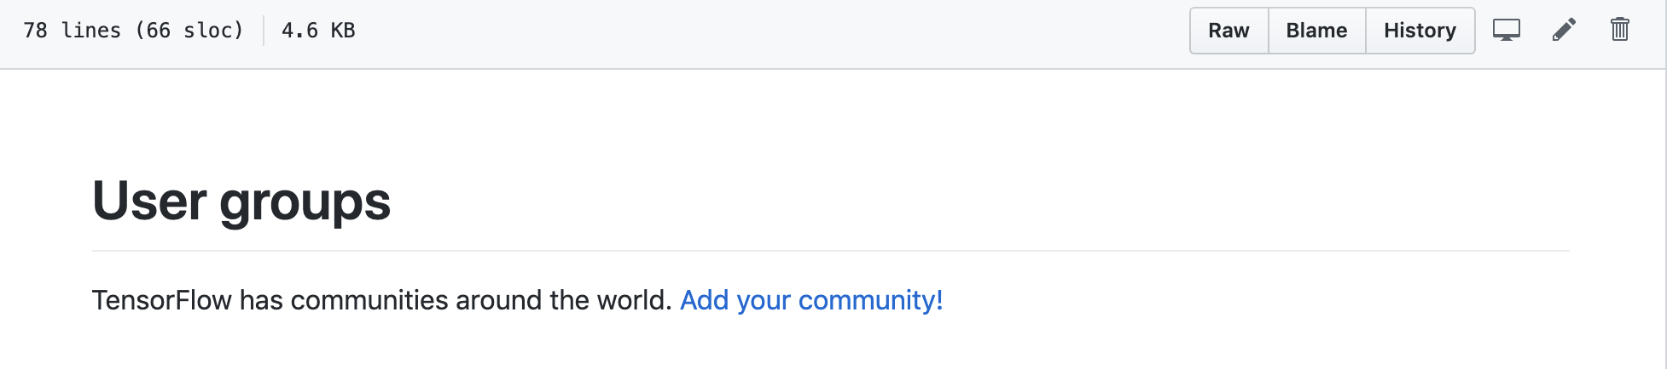
Step 2 : Create a pull request
Go to docs/groups.md at master · tensorflow/docs and click on the pencil icon towards the right
Please ensure to the edit the file in the fork of the project

Slide 6
Step 2 : Create a pull request (Cont)
Edit the file under Asia >> Add * [TFUG XX (your.meetup.page-link)]
Propose a file change : Update groups.md as “New Chapter Request for your City name”
Add additional option description : “Request to start a new TFUG chapter in India”
Click on “Propose a file change”
Congratulations! You have successfully created a request for your meetup. Please let gandhinikita@google.com know once done.

Slide 7



Presence on social media
[Recommended] Share the news about this new community in social media
Feel free to start your own channels on Twitter, Facebook and Instagram.
Kindly mention the chapter description similar to what you have put on meetup.
Linking social media pages to meetup page is a good idea.
Your account names can be @TFUG_XX. Keeping the account/s open to public is a good idea.

Slide 8

A strong Team!

Slide 9
Tips for forming a core team
Do’s and Don'ts
Do consider building a team with diverse backgrounds.
Do consider folks passionate about community contributions. Nothing can replace that.
Do consider folks experienced in technology and community building.
Don’t start a team with specific executive roles, keep rotating responsibilities.

Slide 10

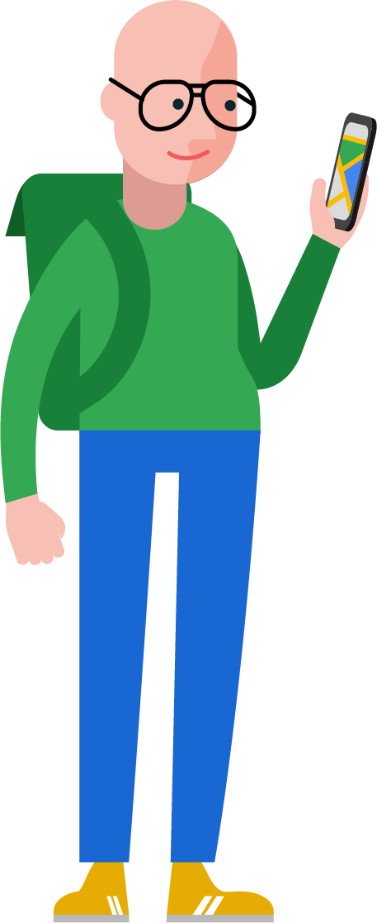


Tips for organising a meetup

Slide 11
Tips for organising a meetup
Planning the event date : Choose the event dates wisely that they don’t overlap with festivals and working hours or any other events.
Involve the core team members in planning of the event.
Planning the event theme : Conduct regular surveys within your community (formally/informally) asking what they want the organisers to plan.
Have variety : Not everyone have the same taste and hence it’s important to think from different minds what could be planned.
Choose a venue which is easily accessible for all to reach using public transport and is centrally located.
Event support : Fill this form for support request for your event. We will carefully review the application before we support the event.
Announce the event on social media : Social media plays an important role in inviting folks not on your list to the event.

Slide 12
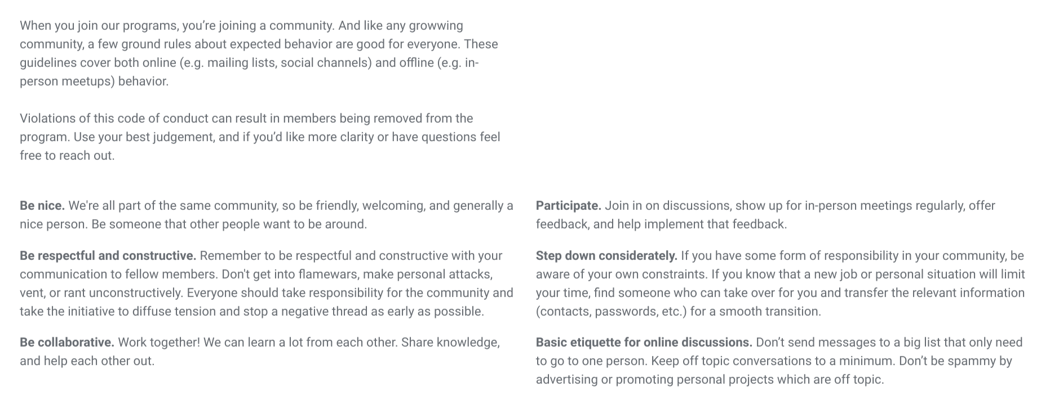
Community guidelines

Slide 13
Logo Usage
Do’s and Don'ts

Slide 14
Questions?
Feel free to reach out to gandhinikita@google.com/ biswajeet@google.com

